Slide 1
Transformation Walks
We will walk around the space as different characters.

Slide 3
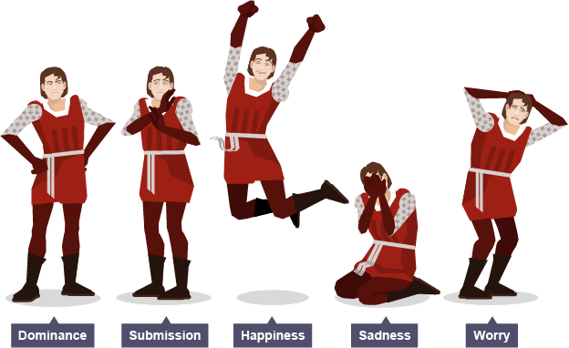

Slide 4
Positions of Body Language

Slide 5
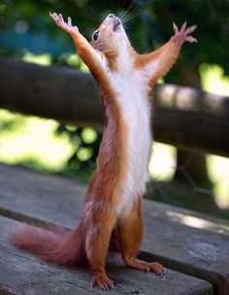
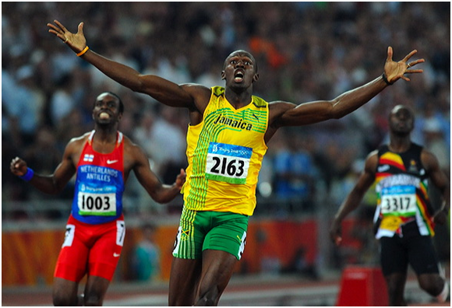
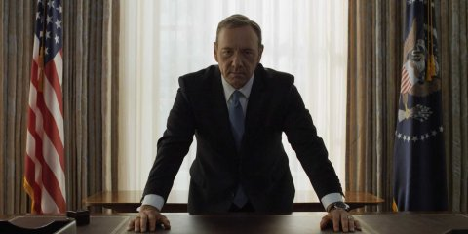
Positions of Power
Expanding of the body
Hands, neck, head raised
Open and commanding

Slide 6
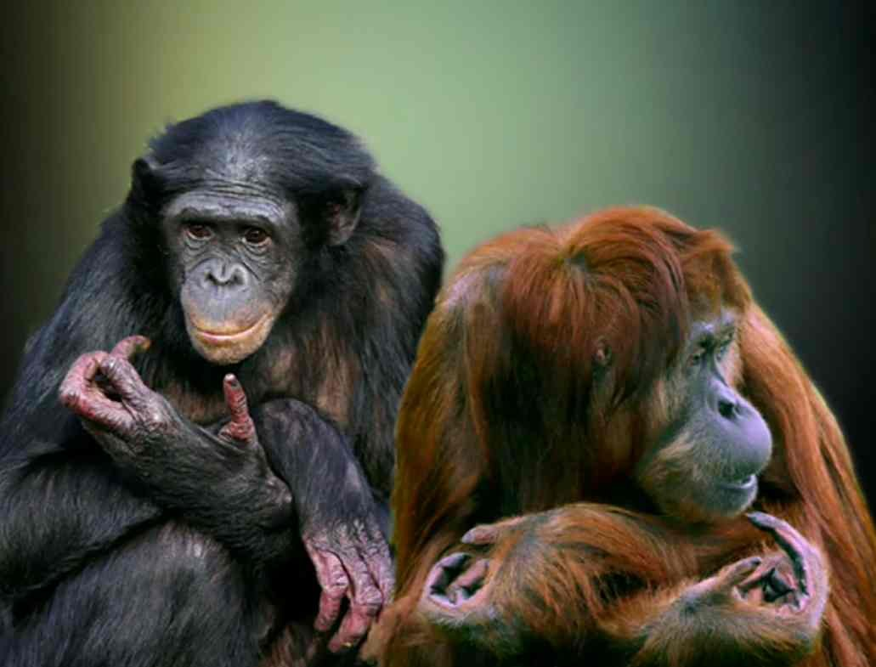
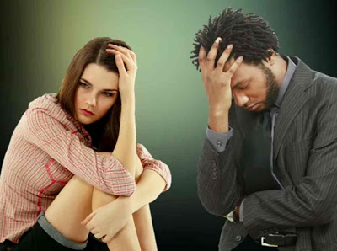
Positions of Powerless
Sunken posture
Arms hiding face, body
Back hunched

Slide 7
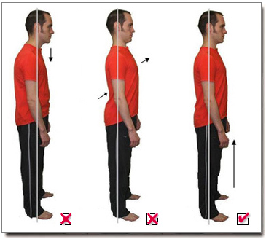
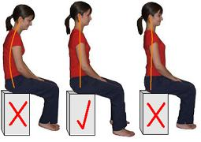
Proper Stage Posture
N eutral
O pen
D efined
S trong

Slide 8
Can you match your partner’s gestures?

Slide 9
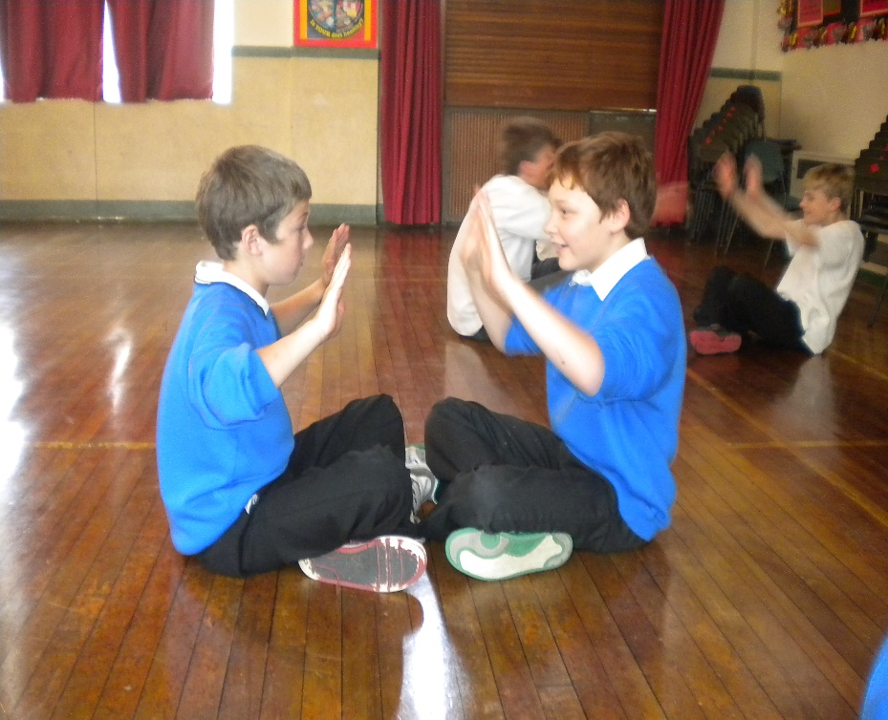
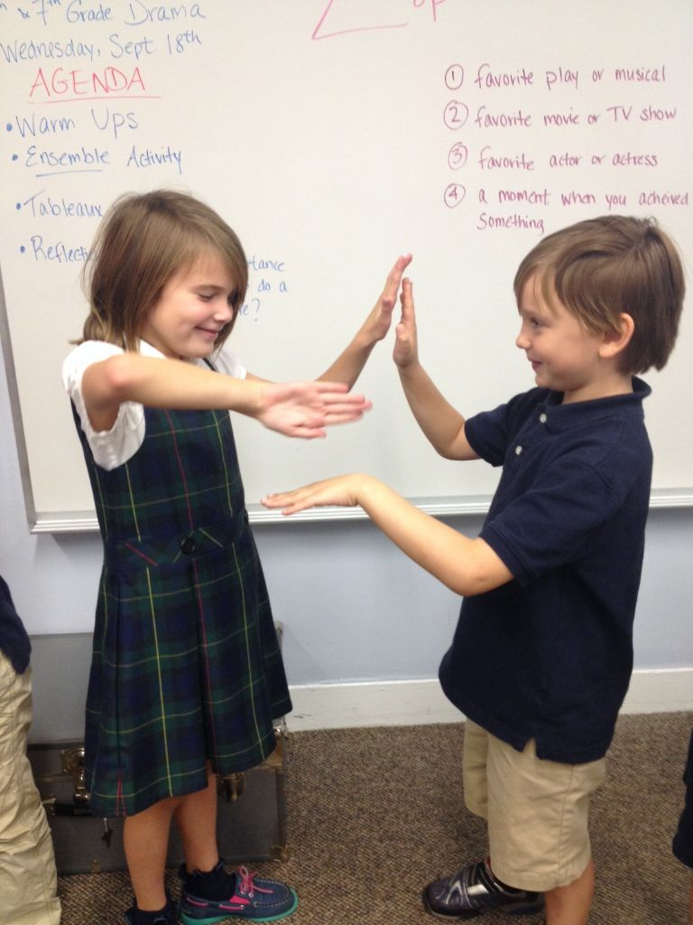
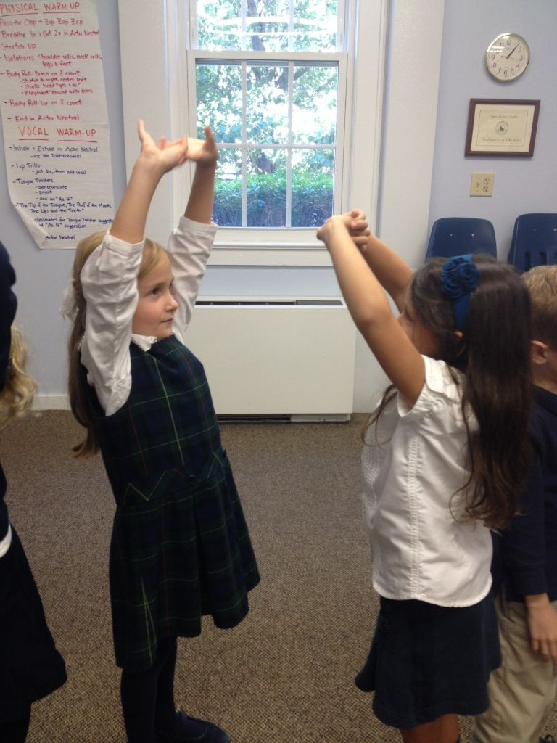
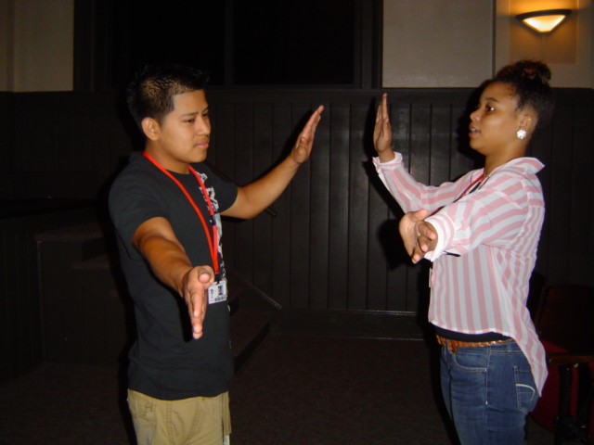
Slow Motion Unison

Slide 10
Pat your head
Wave hello
Brush Your Teeth
Drink some juice
Drive a car
Write your name

Slide 11
Bus Stop
Teacher will give instructions
How old do you think he is? o How did you know that? o What did he do to convey this? o Do you think he was happy about where he was going? Why? o Is there anything he could have done to make his choices clearer?

Slide 12
DO NOW DO NOW
Please take out your IMPROVISATION PROJECT
Have it ready for Mr. Seidel
Sit QUIETLY in your chair
seidelmi@orange.k12.nj.us

Slide 13
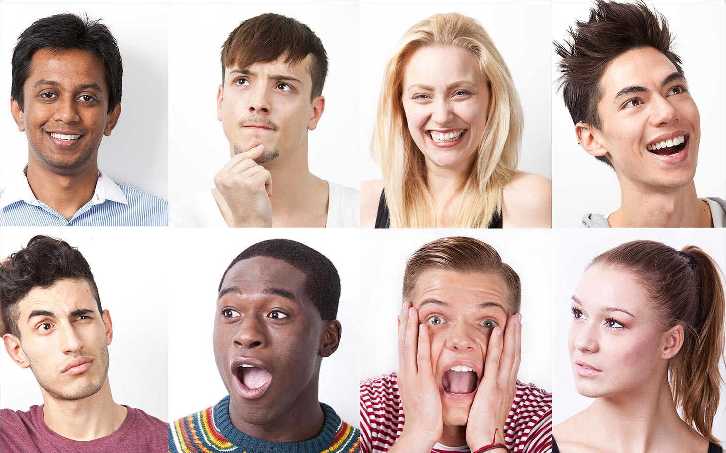
Facial Expressions
Using facial expressions allows the audience to connect to…
Feeling
Motivation
Intent
Mood
https://www.youtube.com/watch?v=dUfS256-jdk

Slide 14
3 Chairs in front of the class
Students sit and bow their heads and close their eyes.
The teacher will give out loud a situation, feeling, emotion, or expression.
After the teacher paints the picture with words, on the count of three the performers in the ‘hot seat’ will raise their heads with a facial expression that they feel best communicates the given emotion.
They must try to freeze their face and bodies so that the class can vote on which actor portrayed the most convening expression.

Slide 15
You just walked into your house late at night and your hear someone upstairs walking around.
You walked into the house and your mother has just baked some fresh cookies.
You heard tires squealing and you turn around and there is a dead dong in the street.
You are taking a shower and you hear a noise outside. You pull back the curtains and there is a peeping tom standing at your window.
You walk into a public bathroom and the sewer is backed up and over flowing out of the toilets.
You wake up on your birthday and your mother is holding a sweet little puppy.
You walk into your kitchen, turn the light on and rats run across your feet.
You walk outside on a warm summer evening and you see the giant moon just starting to rise.

Slide 16
You walk into your living room and you see your mother and father kissing.
You just got a note in class that reads, “Come to the principals office. Immediately!”
You are being yelled at by your father for talking back to your mother.
You just caught your sister stealing some of your money out of your money box.
You have to go to the bathroom really bad, but you’re in the middle of a pew at a church service.
You think you see your best friend at a party from across the room but you not quite sure it’s them because the light is so bad.
You are watching a scary, funny, love, or dumb movie.
Your are watching your favorite team win / lose the championship.
You are asked why you got on F on a test by your teacher.

